Slide 1
Unit : 5
Network Security Aspects
Prepared By:
J.B.VALA

Slide 2
The CIA of Security
Confidentiality
( Information kept private and secure )
Integrity
( Involves maintaining the Consistency, accuracy, and
trust worthness of data over the entire life Cycle . )
Availability
( Systems available to whom requires them ) or
authorized Users can access only.
Protection = Prevention + (Detection + Response )

Slide 3

Introduction and Security Threats
Virus :-
A Virus attaches itself to a program or file enabling it to spread from one computer to another.
Almost all Viruses are attached to an executable file.
It is important to note that a virus cannot be spread without a human action.
Worm :-
A worm is similar to a Virus by design and is considered to be a sub-class of a virus.
It has the capability to travel without any human action.
The main problem with a worm is its capability to replicate itself on your computer.

Slide 4

Intruders ( Hacker or Cracker )
Masquerader ( Unauthorized User ) + ( Outsider )
Misfeasor ( Authorized But misuse of access) + ( Insider )
Clandestine User
(Supervisory Control ) + ( Outsider or Insider )

Slide 5
IDS (Intrusion Detection System)
An IDS is a device or software application that monitors network or system activities for malicious activities or policy violations and produces reports to a management station.
Intrusion
  A set of actions aimed to compromise the security goals, namely Integrity, confidentiality, or availability, of a computing resource.
Intrusion detection
  The process of identifying and responding to intrusion activities.
Functions of IDS:
Monitoring and analyzing both user and system activities.
Analyzing system configuration and vulnerabilities.
Assessing system and file integrity.
Ability to recognize patterns of attacks.
Analysis of abnormal activity patterns.
Tracking user policy violations.

Slide 6
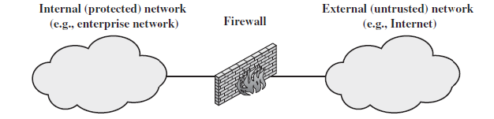
Firewalls
A firewall is a system designed to prevent unauthorized access to or from a private network which is connected to the internet.
A firewall can be implemented in both hardware and software or combination of both.
It is generally located between internal and external networks.
All messages entering or leaving the internet pass through the firewall, Which examines each message and blocks those that do not meet the specified security criteria.

Slide 7
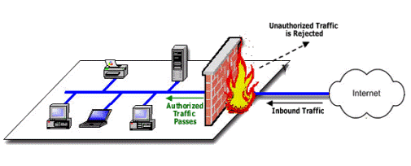
Some of the limitations of the firewall are listed below;
    The firewall cannot protect against attacks that bypass the firewall.
    The firewall does not protect against internal threats.
    The firewall cannot protect against the transfer of virus-infected programs or files.

Slide 8
Access Control of Firewall (Characteristics)
Service control
  Determines the types of Internet services that can be accessed, inbound or outbound
Direction control
  Determines the direction in which particular service requests are allowed to flow through the firewall.
User control
  Controls access to a service according to which user is attempting to access it
Behavior control
  Controls how particular services are used.
  For example, the firewall may filter e-mail to eliminate spam.

Slide 9
How Do Firewalls Work ?
Network Address Translation (NAT )
Basic Packet Filtering
Stateful Packet Filtering
Access Control Lists ( ACLs)
Application layer proxies.

Slide 10
Network Address Translation (NAT)
Translates between external and internal IP addresses. With NAT, a private network can use internal, non-routable IP addresses that map to one or more external IP addresses.
Basic packet filtering
Basic packet filtering looks at each packet entering or leaving the network and then either accepts the packet or rejects the packet based on user-defined rules. Each packet is examined separately.
Stateful packet filtering
Stateful packet filtering also looks at each packet, but it can examine the packet in its relation to other packets. Stateful firewalls keep track of network connections and can apply slightly different rule sets based on whether the packet is part of an established session or not.
Access control lists (ACLs)
ACLs are simple rule sets that are applied to port numbers and IP addresses. They can be configured for inbound and outbound traffic and are most commonly used on routers and switches.
Application layer proxies
An application layer proxy can examine the content of the traffic as well as the ports and IP addresses.

